Slide 1
CLOUD BASED INDUSTRY MONITORING AND CONTROLLING SYSTEM
Team members:
V. Sandhya Sri
A. Nikitha
O. Jhansi
B. Gayathri

Slide 2
INTRODUCTION:
By these project we can detect temperature , gas ,humidity , light. we can reduce harm. System designed to protect industries from losses due to accidents using Internet of things. Gas leakages may lead to fires leading to huge industrial losses. Also low lighting in industries may create improper work conditions increasing the probability of accidents.

Slide 3
COMPONENTS:
ESP32
Temperature sensor
Gas sensor
Jumper wires
Buzzer
LED

Slide 4
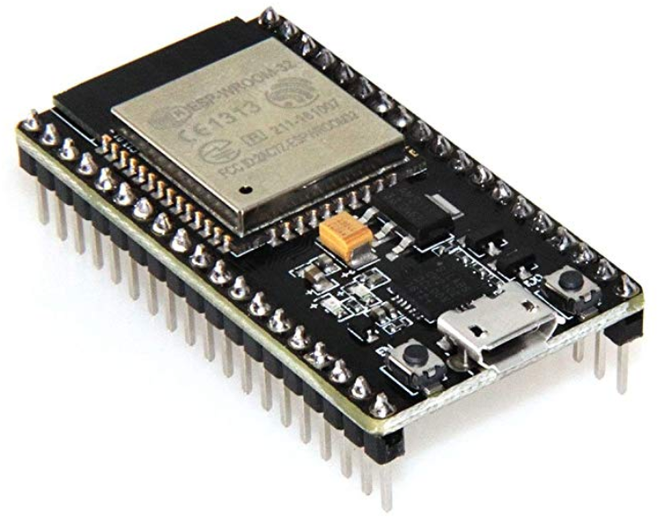
ESP32
ESP32 is a series of low-cost, low-power system on a chip microcontrollers with integrated Wi-Fi and dual-mode Bluetooth.

Slide 5
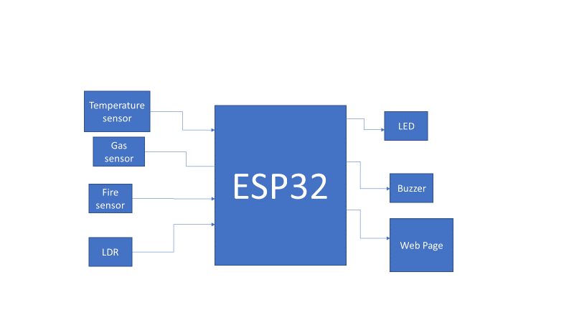
Block diagram:

Slide 6
Temperature sensor:
A temperature is a device that detects and measures hotness and coldness and converts it into an electrical signal. If the difference in voltage is amplified the analog signal is generated by the device and it is directly proportional to temperature.it has three terminals and it requires 5.5v power supply.

Slide 7
Humidity sensor:
A humidity sensor (or hygrometer sensor) measures and report both moisture and air temperature. The ratio of moisture in the air to the highest amount of moister at a particular air temperature is called relative humidity. It work by detecting changes that alter electrical currents or temperature in the air.

Slide 8
Light sensor:
The light sensor is a device which converts light energies of various wavelength some infrared to uv into the electrical energy(or to an electrical signal).These is the reason that they are called photo electric devices.
They sense the light during this process so they can be called as photo sensors.

Slide 9
Gas sensor:
A gas sensor is a device which detects the presence of different gases in an area, especially those gases which might be harmful to humans or animals. The developments of gas sensor technology have found wide applications in environmental monitoring, protection, etc.

Slide 10
Conclusion:
It will detect the temperature, humidity, light and gas .it will sound a buzzer if the value gets increases and if the LDR value increases it makes both buzzer and LED.

Slide 11
THANK YOU

